Slide 1

Digihealth
Group 22:
Abigail Asamoah,
Savio Jose,
Tanaka Tembo,
Dulan Gunuwardena

Slide 2

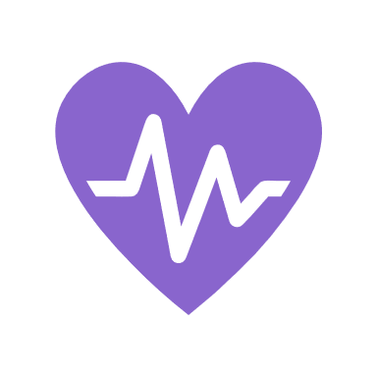


Project Overview
In the United States, about 17.5% of deaths from cardiovascular disease in 2022 were due to stroke. This means that about 1 in 6 deaths were caused by stroke.
Healthcare is becoming increasingly complex and fragmented, with patients with high likelihoods of stroke are often struggling to manage their health
Among those aged under 65, two-fifths of deaths from stroke are linked to smoking
For every 10 people who die of stroke, 4 could have been saved if their blood pressure had been regulated
This disconnection can lead to missed opportunities for timely care all of which can hinder optimal health outcomes
The app integrates all aspects of healthcare into one platform - offering real-time access to appointments, health data, insights for doctors and management, & patient support
Notes:
Predicts stroke based on the machine learning algorithm

Slide 3
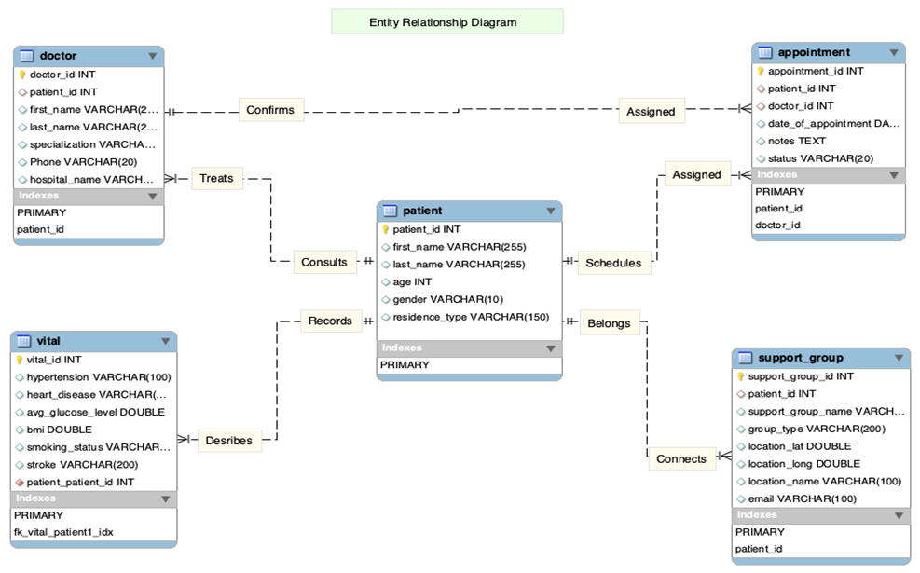
Database Design

Slide 4

Challenges in Creating Sample Data
Several challenges were faced during this data management process, and this includes
Data Consistency: Ensuring valid foreign key relationships between tables (e.g., assigning valid patient_id values in multiple tables) was challenging and mistakes in the relationships will result in integrity errors during testing.
Reality of the data: Creating realistic sample data for attributes like BMI and glucose levels need a research into plausible ranges and categories to ensure meaningful tests are done

Slide 5

Future Work
Evaluate prediction model to include required predictors (age).
Add user specific privileges for accessing application.
UI and DB Design restructuring.
Feedback from users ( patients and doctors).

Slide 6

Shiny App Demo walk through on app

